Slide 1
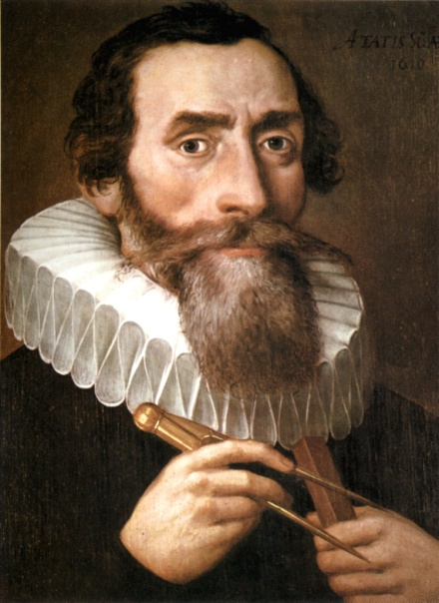
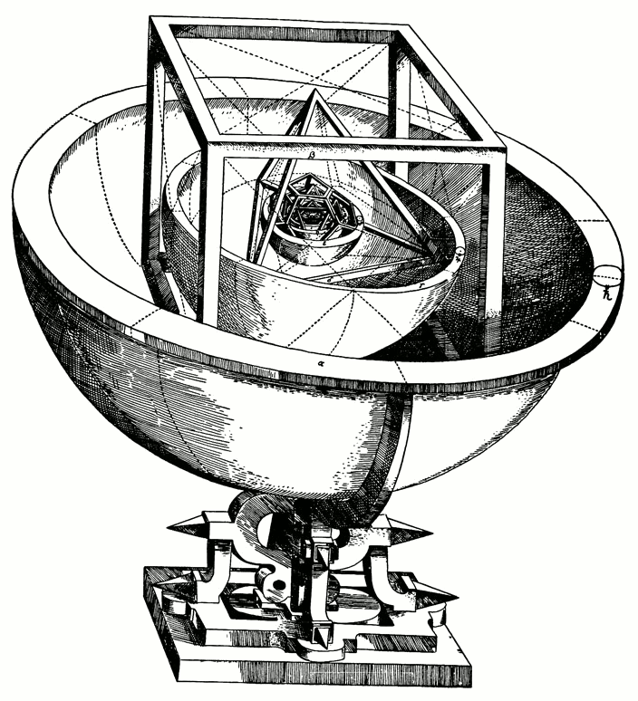
Johannes Kepler: His Life and How He Influenced and Was Influenced by Science
By: Julie Wilson
and John Martin

Slide 2
Kepler’s Early Life
He was born December 27th 1571 in Weil Der Stadt, Germany as a sickly and lonesome boy. He really didn’t having many kind things to refer to his parents as, and for a time he lived with his grandparents. However, at his mother’s witch trial, his mother was proven innocent after Kepler’s defense of her.
Kepler had fascination in a multitude of subjects such as astronomy, astrology, theology, and mathematics.

Slide 3
Kepler’s Religious Science
Kepler had an immediate fundamental belief that religion and science were one in the same. All of the patterns that he discovered he considered as part of God’s amazing plan. His first big step into this mixture of the scientific and religious world was when he was summoned to Graz, a city very much so devoted to their faith, but full of science. Although he first was reluctant to take his supposed position there due to his study in theology, he decided to move there anyway. ☺ Thank goodness!

Slide 4
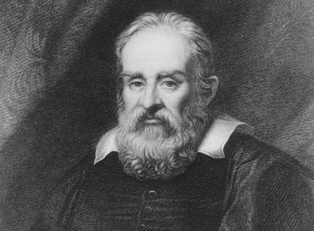
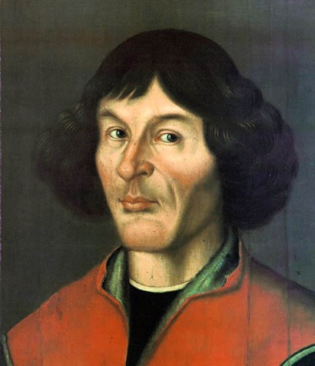
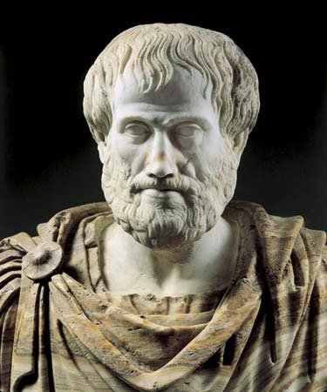
Science Before Kepler
Before Kepler, there were already great strides made in the world of science. These particularly important scientists helped to build a foundation for Kepler to learn from.
Galileo Galilei: Actually lived at the same time as Kepler who wanted to
expand on his laws of
motion.
Nicolaus Copernicus
Aristotle: Kepler had reasonable
knowledge in regards to classical
Latin and Greek.

Slide 5
Kepler’s Education
He studied at the University of Linz, and his alma mater was the University of Tubingen.
At 24-years-old Kepler began to research patterns in regards to planet using Copernicus’s earlier research.
Although Kepler studied quite a bit in theology and Latin, he was eventually appointed imperial mathematician, a position he inherited after Tycho Brahe’s death.

Slide 6
Galileo's Contribution
When Kepler heard about Galileo’s new telescope, he immediately wrote to him, and with this telescope he was able to closely study the behavior of Jupiter.

Slide 7
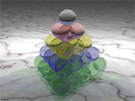
Kepler Finds Cool Things!
Kepler’s Laws of Planetary Motion
Kepler’s Conjecture
The Mysterium Cosmographicum

Slide 8
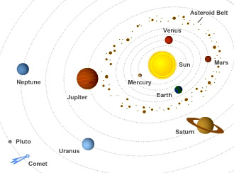
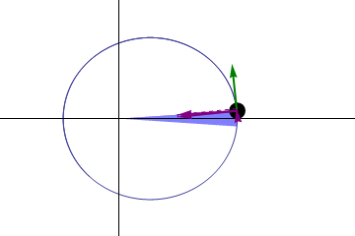
Laws of Planetary Motion
1st Law: The shape of an orbit of each planet is an ellipse with the sun at one foci.
2nd Law: A line joining the planet and the sun sweeps out at equal areas during equal intervals of time
3rd Law: The square of the orbital period of a planet is directly proportional to the cube of the semi-major axis of it’s axis. T^2 = R^3

Slide 9
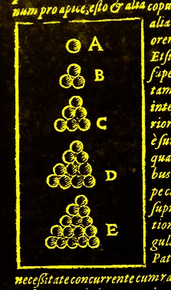
Kepler’s Conjecture
It states that no other arrangement of spheres (of equal size) other than hexagonal close packing and cubic close packing has a greater density per volume ratio.
Thomas Hales proved this theorem. ☺ Like a nice person.

Slide 10
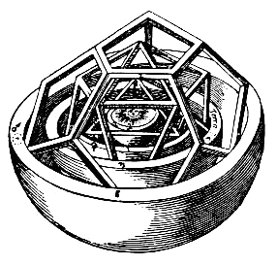
Mysterium Cosmographicum
This book published by Kepler explains his cosmological theory which is based on the Copernican system, in which the five pathagoriam regular polyhedra are used to describe God’s universal plan.
[The image to the right shows the inner core of the object on the left.]

Slide 11
Effects of Religion and Response to Kepler’s Findings
Kepler was both a highly religious and a highly scientific man. He often underestimated his discoveries and as he accepted them, he addressed them as a pattern assigned by God, only strengthening his religious faith.

Slide 12
The Counter Reformation
In the 16th century, a religious movement known as the Reformation was taking place where followers of Luther began to fear for salvation, questioning science and warring with other denominations of Christianity particularly Catholic. In Graz, for fear of the Reformation, laws against Protestant behavior were increasing rapidly, acting as a Counter Reformation and punishing even those who refused to baptize their children.

Slide 13
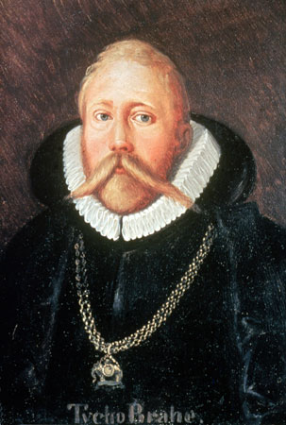
Kepler’s New Best Friend (sort of)
Tycho Brahe!
Brahe invited Kepler to stay with him in Prague, which he accepted after his banishment from Graz; although, Kepler merely stated that he wanted to combine studies, rather than express it has a force of fate.
Tycho Brahe was a very scholarly man with an interest in the planets. Although he was very quiet about his equipment and findings, Kepler gradually began to see the gravity of Brahe’s studies. Brahe greatly cherished his studies, and refused to let them be copied due to his mistrust. However Kepler did become Brahe’s personal assistant until the latter’s death in 1601. It wouldn’t really be until later in life that Kepler could reference and piece together Brahe’s findings.

Slide 14
Banishment!
Eventually Kepler was banished from Graz after avoiding the clergy about the death of his daughter. Fortunately for future science, this forced Kepler to find another place to stay, like with Tycho Brahe. ☺

Slide 15
People Who Borrowed Stuff from Kepler
“When Newton declared that he stood on the shoulders of giants, he was at least partly sincere.” –Edward Dolnick
We continue to learn from Kepler, though at times indirectly through great scientists like Newton and Einstein. Knowledge of former research is very important in making important strides in science.

Slide 16
Newton
Began working on celestial mechanics, gravitation, and planet orbits referencing Kepler’s Law of Planetary Motion.
He proved that the elliptical shape of the orbits of the planets was due to the centripetal force on the planets. (Law of Universal Gravitation)
F= gMm/R^2
Einstein later referenced Newton (who referenced Kepler) in proving his own theorem.

Slide 17
New Findings in the Name of Kepler!
http://www.findingdulcinea.com/news/science/2010/jan/Kepler-Mission-Locates-5-New-Planets.html
NASA’s Kepler mission aims to locate Earth-like planets throughout the galaxy expecting results by 2013.

Slide 18
Works Cited (images included)
Caspar, Max, and Clarisse Doris Hellman. Kepler. New York: Dover Publications, 1993. Print.
Dolnick, Edward. The Clockwork Universe. New York: HarperCollins, 2011. Print.
"Galileo S Telescope: Galileo S Telescope Photos, Wallpapers, Galleries, Galileo Telescope Photo." Explore Profiles and Express Your Opinions on People, Places, Trends and Events. Web. 12 Apr. 2011. <http://connect.in.com/galileo-s-telescope/photos-galileo-telescope-photo-71d699bf4bceacf4.html>.
"Johannes Kepler." Wikipedia, the Free Encyclopedia. Web. 13 Apr. 2011. <http://en.wikipedia.org/wiki/Johannes_Kepler>. *image*
"Kepler Conjecture." Wikipedia, the Free Encyclopedia. Web. 13 Apr. 2011. <http://en.wikipedia.org/wiki/Kepler_conjecture>. *image*
"Solar System." Solcomhouse Home Page. The Ozone Hole Inc. Web. 12 Apr. 2011. <http://www.solcomhouse.com/solarsystem.htm>. *image*
Van Helden, Albert. "Science | Johannes Kepler." The Galileo Project. 30 June 2005. Web. 13 Apr. 2011. <http://galileo.rice.edu/sci/kepler.html>.

